Slide 1
Chapter Two Basic fiber theory
2.1 The basic equations of fiber optics
2.2 Waveguide field equation and eigen solution of guided modes
2.3 Fiber loss and the measurement methods
2.4 Fiber dispersion and the measurement methods

Slide 2

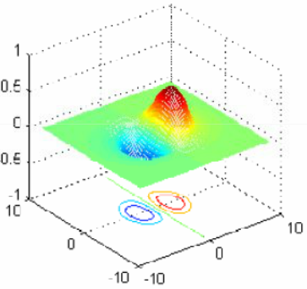
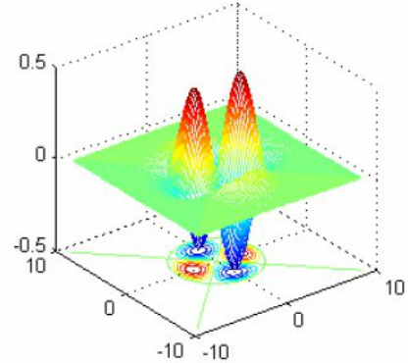
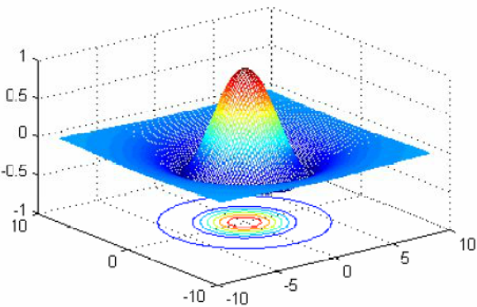
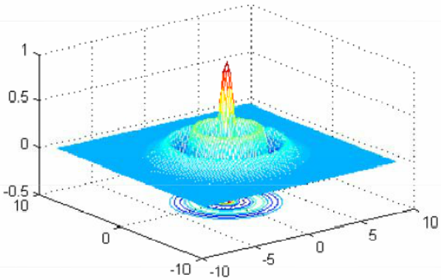
Fiber modes
Optical fiber: a kind of waveguide
There are some certain field distributions which remain unchanged during propagation.
Such field distributions are called modes of the fiber.
Each mode corresponds to one solution of Maxwell equations.
TE01;TM01 mode
TE04;TM04 mode
EH11 mode
EH21 mode

Slide 3
Approaches
Two main approaches are commonly used to analyze the mode characteristics in the optical fiber.
(1) Ray theory —— Geometrical Optics
(2) Wave theory —— Wave optics
Ray theory
Fiber core is much larger than optical wavelength λ₀
The light wave can be regarded as some beams
Therefore, the ray theory can be employed to investigate the light incidence, propagation path, time delay, etc.
Advantages：
Simple
Available for large core (multimode) fiber
Disadvantages：
Unable to explain some cases: mode distribution, cladding modes, mode coupling, etc.
Significantly large deviations in the case of analyzing single mode fiber (fiber core comparable to λ₀).

Slide 4
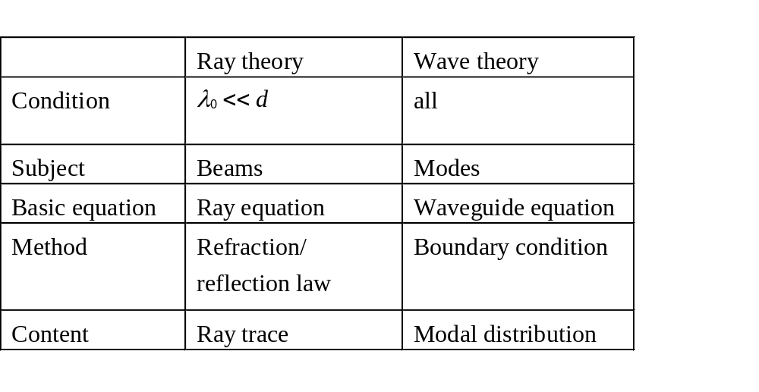
Wave theory
Performed by a rigorous analysis
To solve the Maxwell equations
Originating from electromagnetic wave thus deriving the field distribution of electromagnetic wave.
Advantage: It is available for analyzing both single- and multi-mode optical fibers with different refractive index profiles because of not making any approximations
Disadvantage: the analysis is comparatively complex
Comparison of two above theories

Slide 5
The path of wave theory
Here we focus on investigating wave theory ?
Electromagnetic separation
Time-space separation
Maxwell equations
Wave
equations
Helmholtz equation
Transverse-longitudinal separation
Waveguide field equation
Field distribution
Eigenvalue
Boundary conditions

Slide 6
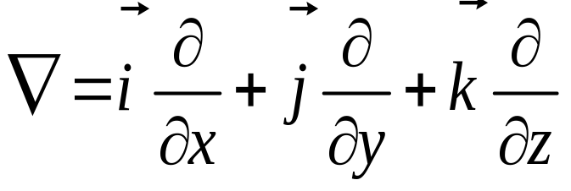
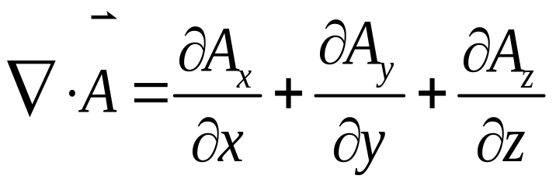
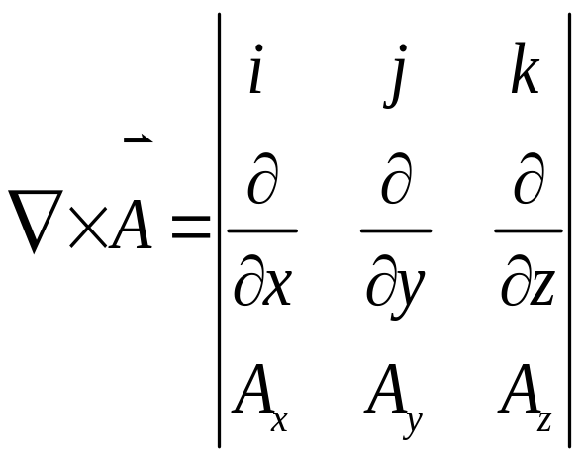
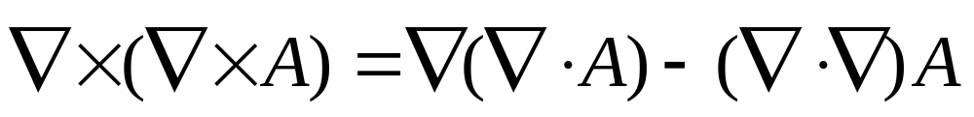
The path of wave theory
Hamilton operator
divergence
curl

Slide 7
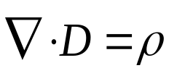

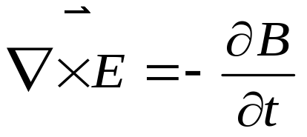
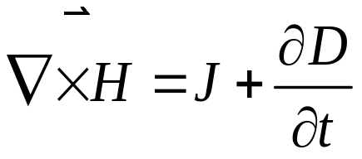
2.1.1 Maxwell and wave equations
The path of wave theory
a) Maxwell equations
Gauss' Law of electric fields
In differential form:
Gauss' Law of magnetic fields
(static electric field and magnetic field)
Faraday' Law of electromagnetic induction
The Law of total currents
(The relationship between dynamic electric field and magnetic field)
where E、D、B、H are electric field intensity, electric induction intensity, magnetic induction intensity and magnetic field intensity, respectively. ρ is electric charge volume density. J is surface current density.

Slide 8
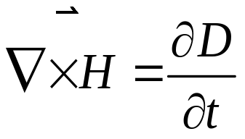

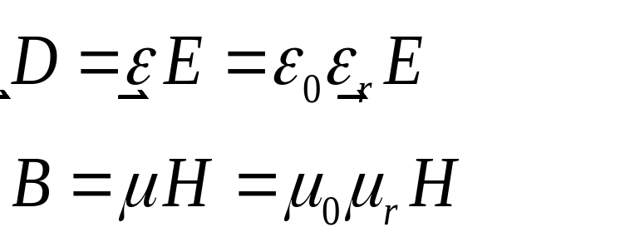
The path of wave theory
Optical fiber is one type of optical waveguides having the following characteristics:
① no conduction current: J=0
② no free charge: ρ=0
③ linear isotropic 线性各向同性
b) material equations
ε₀ is the dielectric constant in vacuum （8.8542×10⁻¹²Fm⁻¹）
ε_{r} is the relative dielectric constant
μ₀ is the magnetic conductivity in vacuum（4π×10⁻⁷Hm⁻¹）
μ_{r} is the relative magnetic conductivity

Slide 9
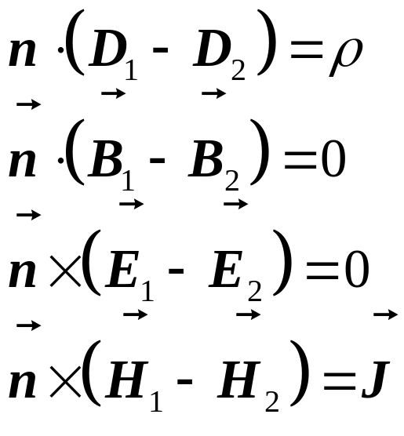
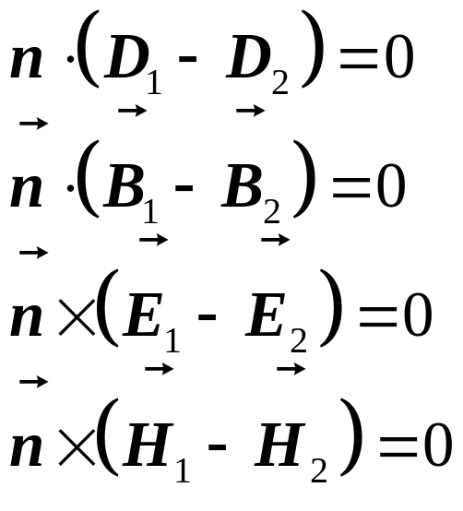
The path of wave theory
c) Boundary conditions
At the dielectric surface
J＝0，ρ＝0
The tangential components of H and E are continuous 切向分量
The normal components of B and D are continuous

Slide 10
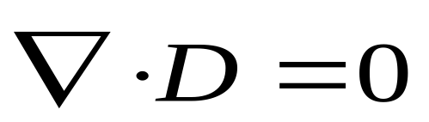
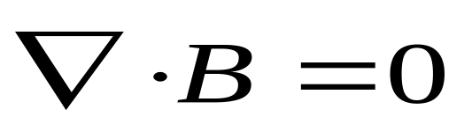
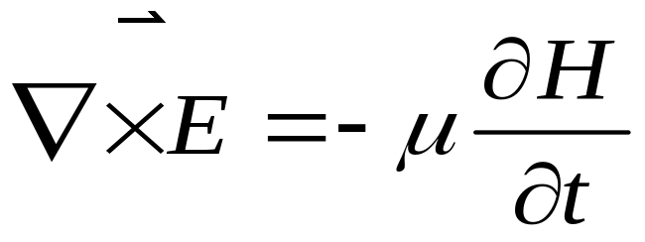
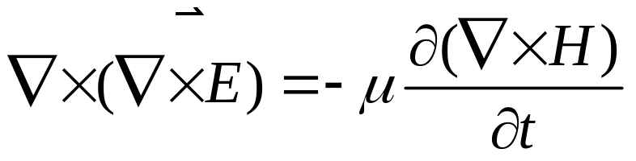
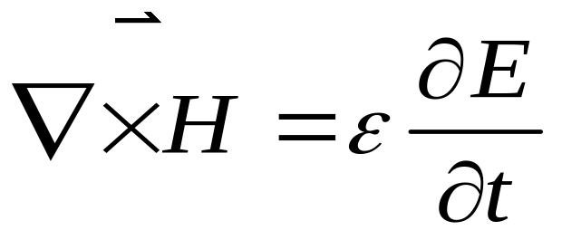
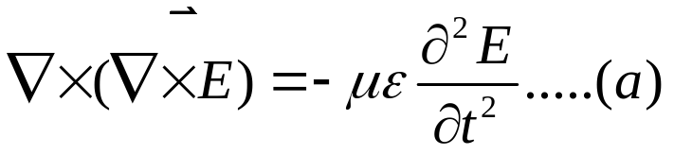
The path of wave theory
Electromagnetic separation
Maxwell equations wave equations

Slide 11
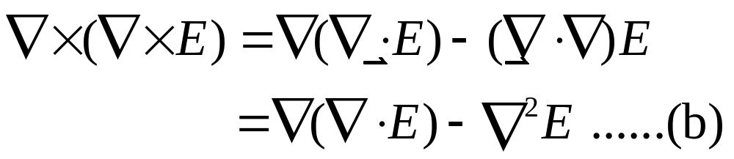
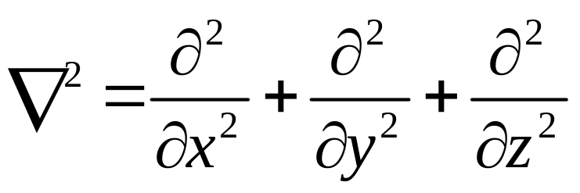
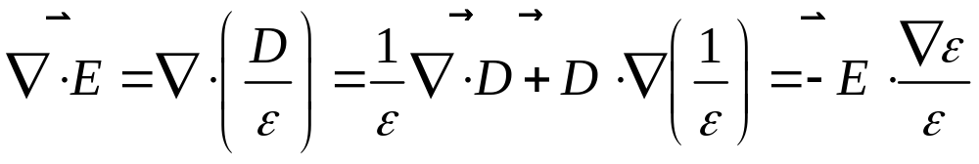
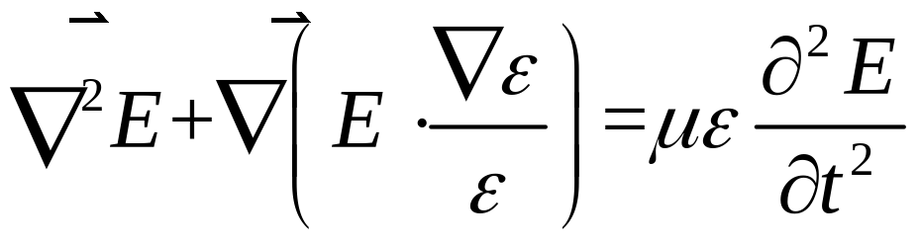
The path of wave theory
Laplace operator
Therefore

Slide 12
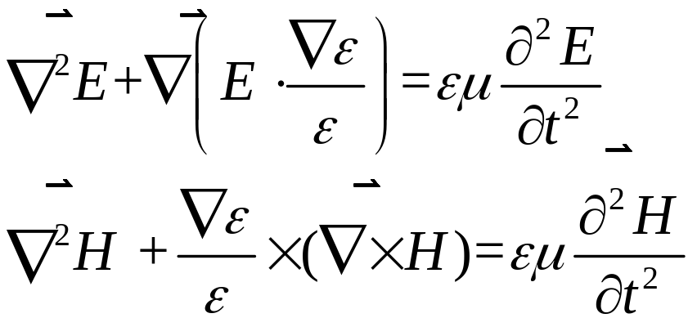

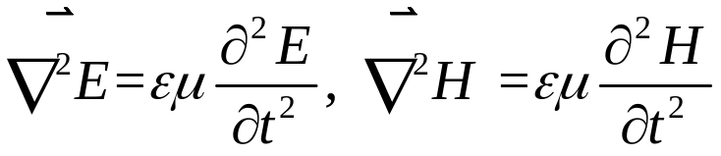
The path of wave theory
Similarly, we can derive the wave equation relating to H and obtain
Vector wave equations:
The precise equations of electromagnetic wave.
In fiber，the refractive index variation is significantly moderate, thus .The above vector wave equations can be simplified to scalar wave equations
  Notice: These equations are the approximated results only valid for solving the general problems in fiber.
  If more precise analysis is required, the vector equations are needed.
The formulas are valid for each component of E (x,y,z,t) and H (x,y,z,t)

Slide 13
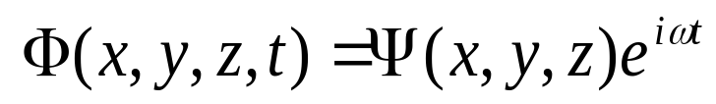
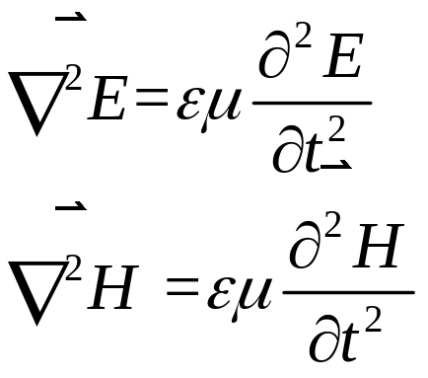
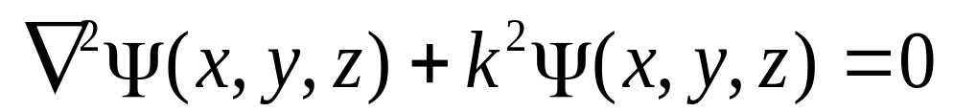
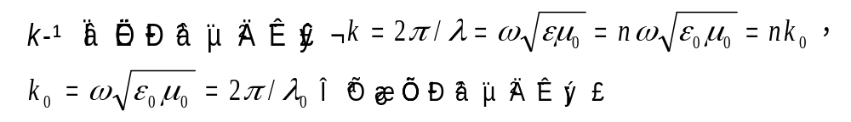
2.1.2 Helmholtz equation
Wave equations Helmholtz equation
Time-space separation
set
scalar wave equations
This is the Helmholtz equation
k is the wave number
is the wave number in vacuum

Slide 14

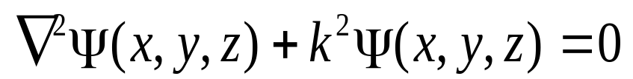
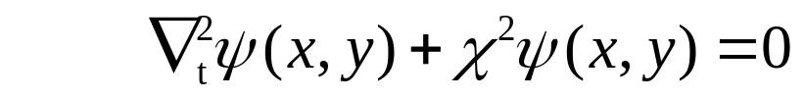
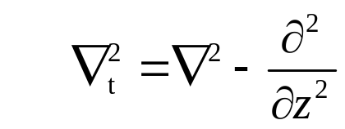
2.1.3 Waveguide field equation
Helmholtz equation Waveguide field equation
Transverse-longitudinal separation
Light transmission characteristics in optical fibers:
In the transverse direction: standing wave
In the longitudinal direction: travelling wave
Only phase without amplitude variations exists for the field distribution along longitudinal direction
Transverse-longitudinal separation
set
Substituting the formula into the Helmholtz equation
Laplacian operator at transverse direction

Slide 15


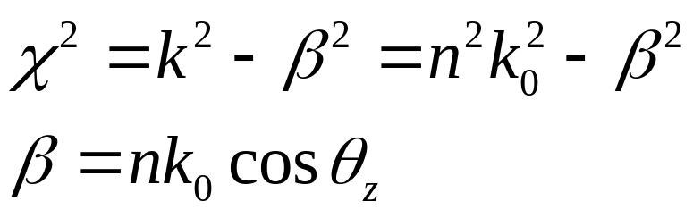
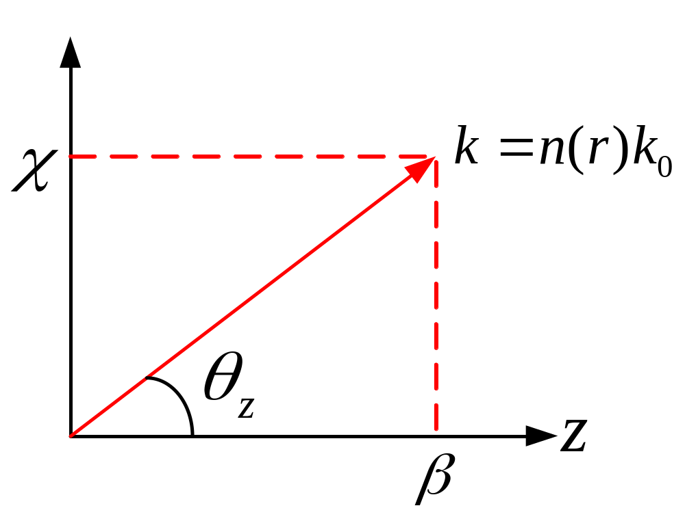
2.1.3 Waveguide field equation
propagation constant at transverse direction
propagation constant at longitudinal direction

Slide 16
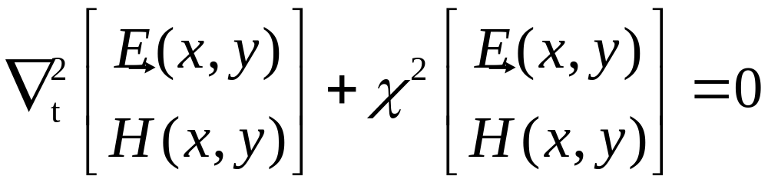
2.1.3 Waveguide field equation
The transverse distribution of electric field E and magnetic field H should meet
waveguide field equation
It is the basic equation of wave theory and also a typical eigen equation, the eigenvalue is χ or β.
If the boundary condition is given, the eigen solution and its corresponding eigenvalue can be obtained. In general, the eigen solution is defined as the mode.

Slide 17
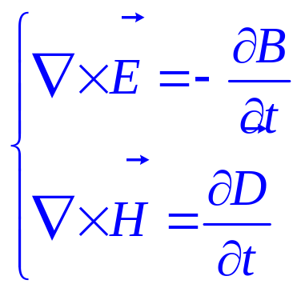
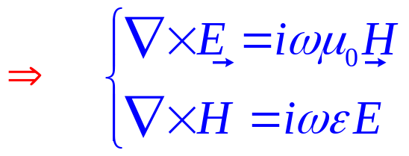
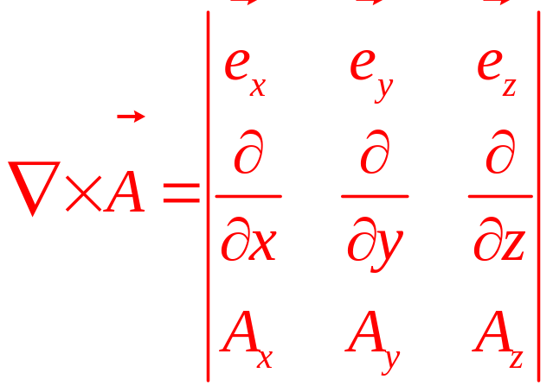
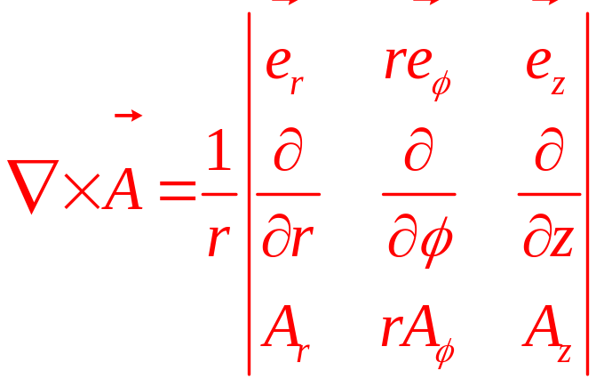
2.1.4 Mode and its basic properties
Field distribution （i.e., eigen solution）
The mode field distribution is uniquely determined by six field components: rectangular coordinate system：E_{x} , E_{y} , E_{z} , H_{x} , H_{y} , H_{z}
cylindrical coordinate system：E_{r} , E_{φ} , E_{z} , H_{r} , H_{φ} , H_{z}
Time-space separation:
Maxwell equations：
According to ：

Slide 18
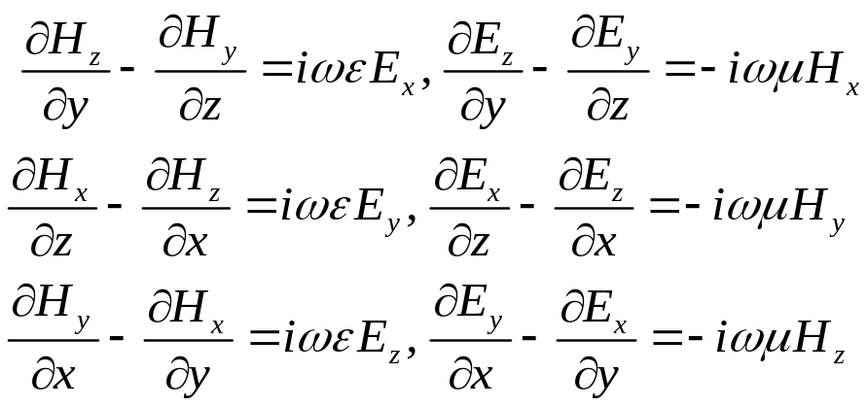
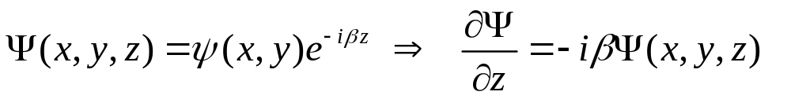
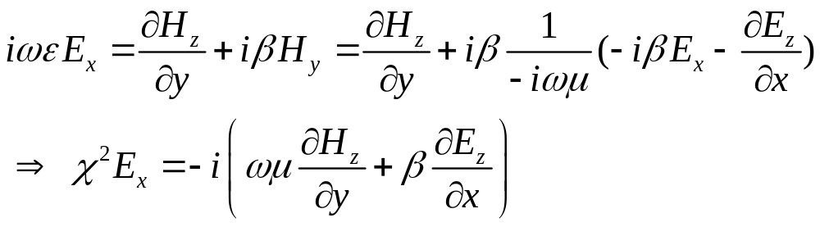
In rectangular coordinate system, each component can be expressed as the following
2.1.4 Mode and its basic properties
x component
y component
z component
After space separation
Take E_{x} component as an example

Slide 19
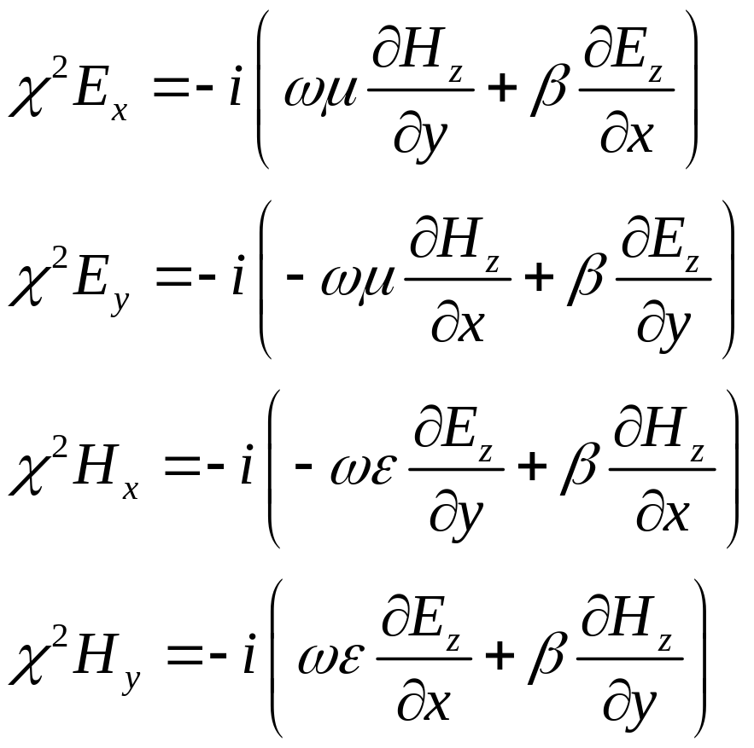
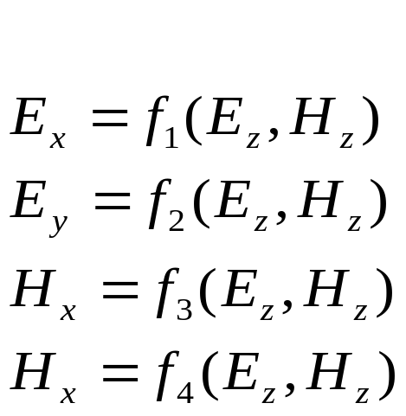
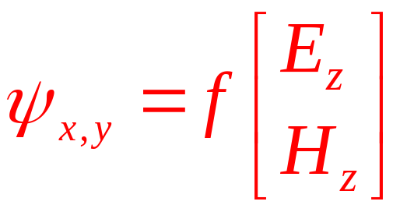
In rectangular coordinate system, the relationship between transverse and longitudinal coordinates
2.1.4 Mode and its basic properties

Slide 20
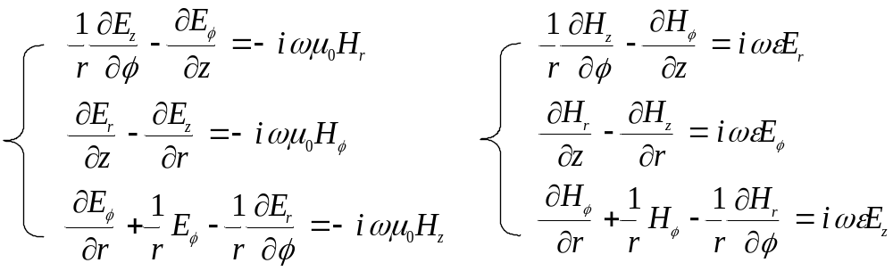
2.1.4 Mode and its basic properties
In cylindrical coordinate system

Slide 21
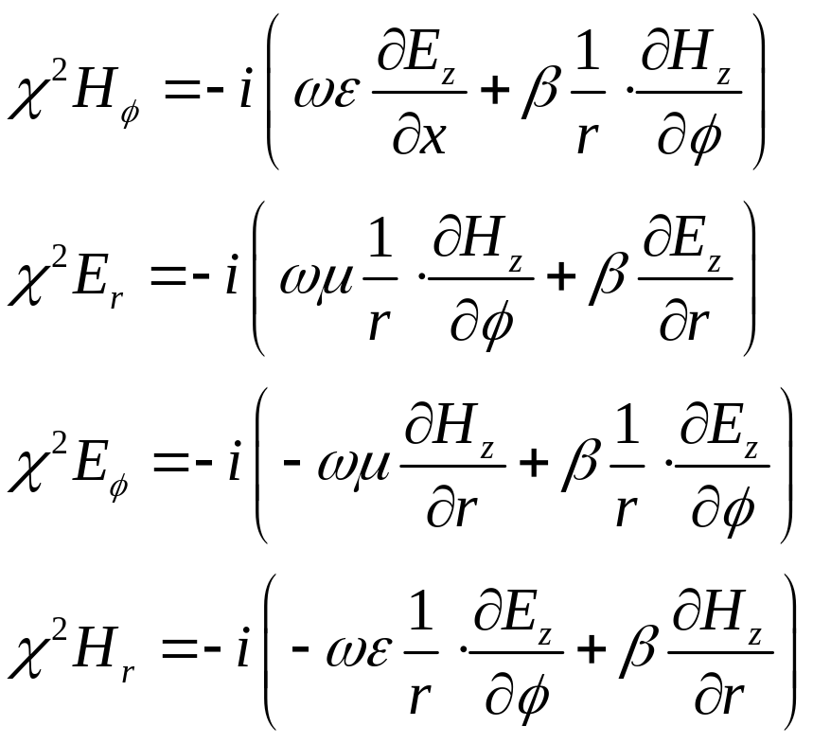


2.1.4 Mode and its basic properties
In cylindrical coordinate system, the relationship between transverse and longitudinal coordinates

Slide 22



2.1.4 Mode and its basic properties
The transverse components can be obtained from the longitudinal components, thus the 6 field components can be simplified to 2 longitudinal components
E_{z} and H_{z} satisfy waveguide field equation independently
The relationship between transverse and longitudinal components
If the transverse components are known, the longitudinal components can be solved
In rectangular coordinate system
In cylindrical coordinate system

Slide 23
(1) The name of modes
According to that whether longitudinal component E_{z} and H_{z} exist or not, the modes can be named as:
(1) TEM: E_{z}＝H_{z}＝0;
(2) TE: E_{z}＝0, H_{z}≠0;
(3) TM: E_{z}≠0, H_{z}＝0;
(4) HE or EH: E_{z}≠0, H_{z}≠0。
Most modes in fiber are HE (EH) modes, sometimes there are some TE (TM) modes

Slide 24



(2) Longitudinal propagation constant (β)
Phase variation rate per unit length along z direction
The component of wave vector k along z direction
The values of b are separated and correspond to a group of guided modes
If different guided modes correspond to a same b, they are degenerate

Slide 25



(3) Normalized frequency (V)
In a given fiber, the allowed guided modes are determined by the structure parameter which is characterized by normalized frequency V. Larger V leads to more guided modes.
Numerical aperture
Relative refractive index difference

Slide 26

(3) Normalized frequency (V)
Guided mode cutoff： For a certain V, the modes except fundamental mode maybe not allowed and the guided mode will be converted to radiation mode. This V (labeled V_{c}) is called the cutoff frequency for a specific guided mode.
Different guided modes have different V_{c}
Guided mode cutoff
Guided mode far from cutoff：If the guided mode eigen value β approaches n₁k_{0 ,} the guided mode field will be restricted tightly within the core. This is called as guided mode far from cutoff condition.

Slide 27





(4) Transverse propagation constant（U,W）
Transverse propagation constant ：
(core)
(cladding)
Transverse constant：
Satisfy：
Normalized propagation constant：

